Slide 1
Decision Trees and Gini Index
Daarol, Frodese
Hussain, Faizan

Slide 2
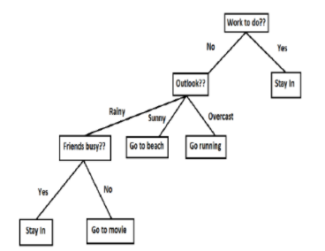
INTRODUCTION – DECISION TREES
Decision trees:
mimic the humans’ decision-making process by answering a series of question(s) and arriving at a decision.
asks a question and classifies (branches out) based on the answer.
Parts of a Decision Tree:
root
internal nodes
edges
leaf nodes / leaves – single classification on every leaf
Figure 1: Decision Tree
Adapted from [1]

Slide 3
INTRODUCTION – DECISION TREES
Leaf Nodes can be:
categorical – as shown on the example
or numerical – e.g “on a scale of 1-10”
it can be a mix of both!
Figure 1: Decision Tree
Adapted from [1]

Slide 4
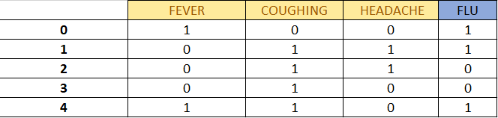
DECISION TREE MAKING EXAMPLE
Given the following raw data set, how do we turn it into a meaningful decision tree that can help predict outcomes?
Standard Notation: N = 5 and M = 4 features,
where N denotes # of observations and M is # of features.
Figure 2: Building a Classification Tree
Adapted from [2]

Slide 5
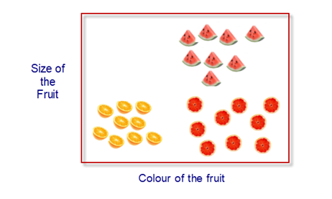
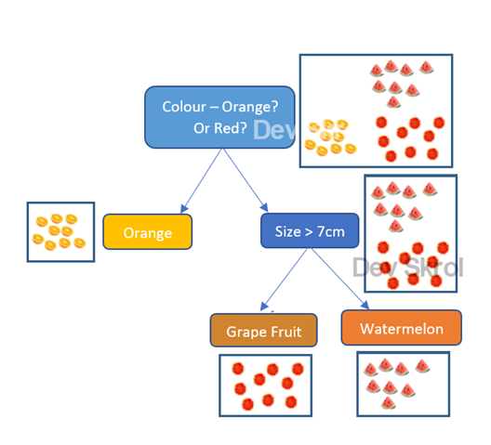
CLASSIFICATION TREE and GINI INDEX
How do we decide which row/feature should be on the root node?
GINI INDEX – this is a measurement used to quantify the purity of a node in a decision tree.
*how well an M Feature defines a classification (leaf node)
Figure 3: Decision Tree Splitting
Adapted from [3]

Slide 6

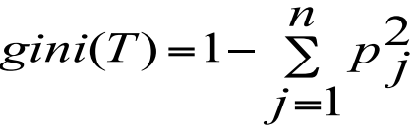
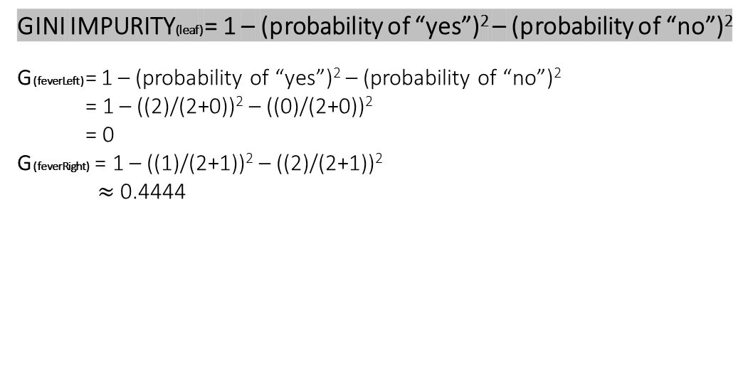
COMPUTATION – GINI INDEX
Step 1: Compare how each feature defines the classification “FLU”
FEVER
YES
NO
Figure 2: Building a Classification Tree
Adapted from [2]
2/0
1/2
Eq. (1)
GINI IMPURITY(leaf) = 1 – (probability of “yes”)² – (probability of “no”)²
G(feverLeft) = 1 – (probability of “yes”)² – (probability of “no”)²
= 1 – ((2)/(2+0))² – ((0)/(2+0))²
= 0
G(feverRight) = 1 – ((1)/(2+1))² – ((2)/(2+1))²
$≈$ 0.4444
Figure 4: Gini Index
Adapted from [4]

Slide 7


COMPUTATION – GINI INDEX
$Since the gini impurities of both left and right are not equal, we have to find the Gini Split Index$(1)
G(feverLeft) = 0 $≠$ G(feverRight) $≈$ 0.4444
Gini(FEVER) =
= $\frac{N_{1}}{N}gⅈnⅈ\left(feverLeft\right)+\frac{N_{2}}{N}gⅈnⅈ\left(feverRight\right)$
= ((2)/5)(0) + ((3)/5))(0.4444)
$≈$ 0.2666 = Gini(FEVER)
We repeat this process to find out the Gini Indices for Coughing and Headache too.
FEVER
$$\frac{N_{1}}{N}⋅gⅈnⅈ\left(T_{1}\right)+\frac{N_{2}}{N}⋅gⅈnⅈ\left(T_{2}\right)$$
YES
NO
2/0
1/2

Slide 8
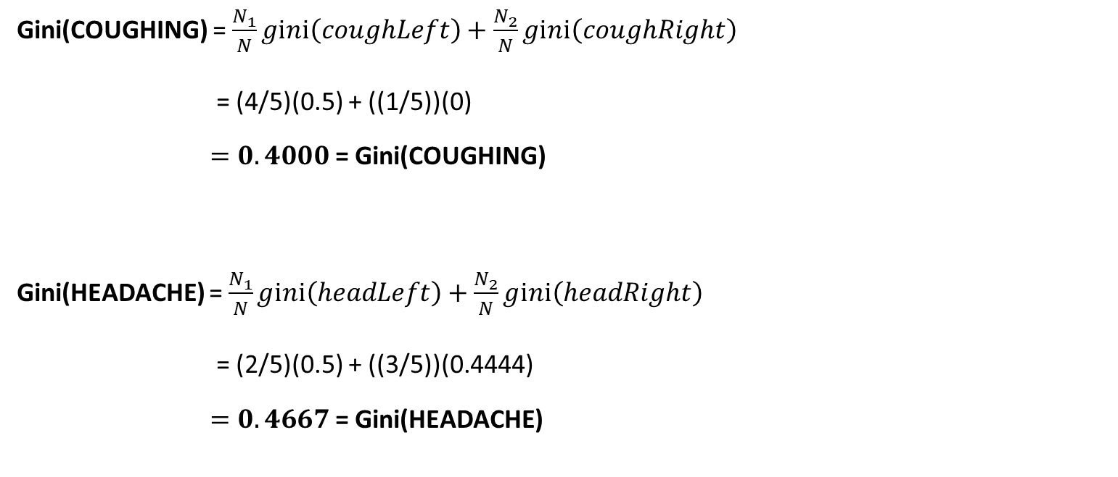
COMPUTATION – GINI INDEX
Gini(COUGHING) = $\frac{N_{1}}{N}gⅈnⅈ\left(coughLeft\right)+\frac{N_{2}}{N}gⅈnⅈ\left(coughRight\right)$
= (4/5)(0.5) + ((1/5))(0)
$=0.4000$= Gini(COUGHING)
Gini(HEADACHE) = $\frac{N_{1}}{N}gⅈnⅈ\left(headLeft\right)+\frac{N_{2}}{N}gⅈnⅈ\left(headRight\right)$
= (2/5)(0.5) + ((3/5))(0.4444)
$=0.4667$= Gini(HEADACHE)
COUGHING
YES
NO
2/2
1/0
HEADACHE
YES
NO
1/1
2/1

Slide 9
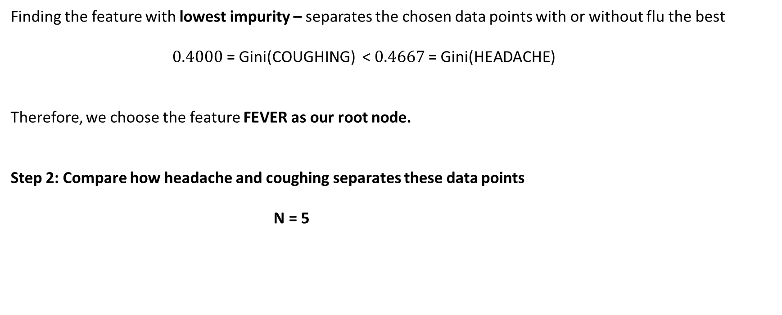
COMPUTATION – GINI INDEX
Finding the feature with lowest impurity – separates the chosen data points with or without flu the best
$0.4000$= Gini(COUGHING) < $0.4667$= Gini(HEADACHE)
Therefore, we choose the feature FEVER as our root node.
Step 2: Compare how headache and coughing separates these data points
N = 5
0.2666 = Gini(FEVER) <
FEVER
YES
NO
2/0
1/2

Slide 10
COMPUTATION – GINI INDEX
Finding the Gini Indices of Coughing and Headache relative to Fever data set
GINI(coughing) = 0.5
GINI(headache) = 0 (Note: 0 means it’s pure! This will be a leaf node)
FEVER
YES
NO
2/0
1/2
HEADACHE
YES
NO
0/0
0/2
COUGHING
YES
NO
1/0
1/0

Slide 11
COMPUTATION – GINI INDEX
Therefore, this will be our current decision tree:
N = 5
FEVER
YES
NO
N = 2
N = 3
HEADACHE
1/2
NO
FLU

Slide 12
COMPUTATION – GINI INDEX
FEVER
GINI(coughing) = 0
(Note: 0 means it’s pure! This will be a leaf node)
YES (1)
NO (0)
2/0
1/2
COUGHING
YES (1)
NO (0)
3/0
0/0

Slide 13
COMPUTATION – GINI INDEX
N = 5
FEVER
YES
NO
N = 2
N = 3
HEADACHE
COUGHING
NO
YES
FLU (2/0)
FLU (3/0)
Note: Doesn’t really make sense for this example as we only used N = 5

Slide 14
Pseudocode
gini(examples, attributes)
Assume that the targetAttribute, which is the attribute whose value is to be predicted by the tree, is a class variable. '‘’
node = DecisionTreeNode(examples)
# handle target attributes with arbitrary labels dictionary = summarizeExamples(examples, targetAttribute)
for key in dictionary:
if dictionary[key] == total number of examples
node.label = key
return node
# test for number of examples to avoid overfitting
if attributes is empty or number of examples < minimum allowed per branch:
node.label = most common value in examples #(occurences)
return node
bestA = the attribute with the least gini index value
node.decision = bestA
for each possible value v of bestA:
subset = the subset of examples that have value v for bestA
if subset is not empty:
node.addBranch(gini(subset, targetAttribute, attributes-bestA))
return node

Slide 15
APPLICATION FIELDS
Visualization of business models (credit cards / loans / etc.)
Engineering – quality control
Health – early diagnosis

Slide 16
Identifying the underlying effects of
COVID – 19 Pandemic
on students’ drop rates

Slide 17


DATA SET
We asked students to answer a form via Google Forms.

Slide 18
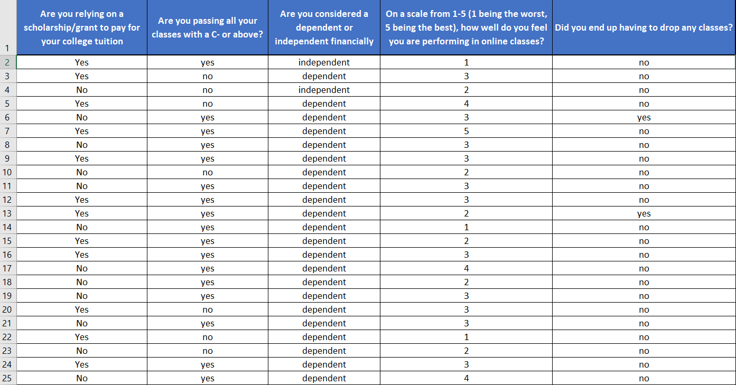
DATA SET
A preview of our results:
N = 40 and M = 4

Slide 19
Building the Decision Tree By Hand- Brief Overview
Created using the questions we had asked for the data set and their results
Used to predict whether a student will drop a class or not
First, we chose which question will become the root node
- Check how well each question can predict if the student will drop a class or not

Slide 20
Do you rely on a scholarship/grant to pay for tuition? (question 1)
Are you passing all your classes with a C- or above?
(question 2)
Yes
No
Yes
No
Drops A Class
Drops A Class
Drops A Class
Drops A Class
Yes
No
Yes
No
Yes
No
Yes
No
4
20
1
15
4
24
1
11
Are you dependent or independent?
(question 3)
How well do you think you are doing in your classes?
(question 4)
3-5(good)
1-2(bad)
Dependent
Independent
Drops A Class
Drops A Class
Drops A Class
Drops A Class
Yes
No
Yes
No
Yes
No
Yes
No
4
28
1
7
3
17
2
18

Slide 21
All the leaf nodes created are impure
To measure impurity, we must use gini impurity
Gini impurity for each node = 1- (probability of "yes")^2 - (probability of "no")^2
Total gini impurity : Weighted average of the leaf node impurities
Gini Impurity for question 1:
Left node: 1 - (4/24)^2 - (20/24)^2 = ?
Right node: 1 - (1/16)^2 - (15/16)^2 = ?
Total gini Impurity: ((24/40) * ?) + ((16/40) * ?)

Slide 22
Gini Impurity for question 2:
Left node: 1 - (4/28)^2 - (24/28)^2 = ?
Right node: 1 - (1/12)^2 - (11/12)^2 = ?
Total gini Impurity: ((28/40) * ?) + ((12/40) * ?) = ?
Gini Impurity for question 4:
Left node: 1 - (3/20)^2 - (17/20)^2 = ?
Right node: 1 - (2/20)^2 - (18/20)^2 = ?
Total gini Impurity: ((20/40) * ?) + ((20/40) * ?) = ?
Gini Impurity for question 3:
Left node: 1 - (4/32)^2 - (28/32)^2 = ?
Right node: 1 - (1/8)^2 - (7/8)^2 = ?
Total gini Impurity: ((32/40) * ?) + ((8/40) * ?) = ?

Slide 23
Find the lowest gini impurity and make that the root node
Follow this method of gini impurity comparison to expand on each child of the root node until nearly all leaf nodes are pure

Slide 24
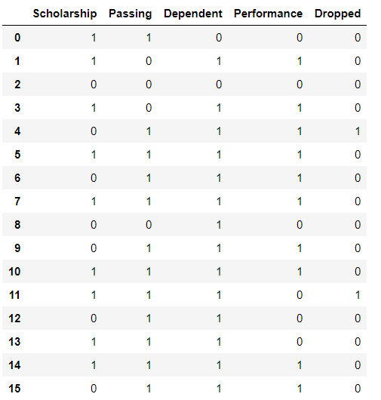
DATA SET – Building the Decision Tree
Language used: Python
Environment: Jupyter
Runtime: 0.57174833

Slide 25
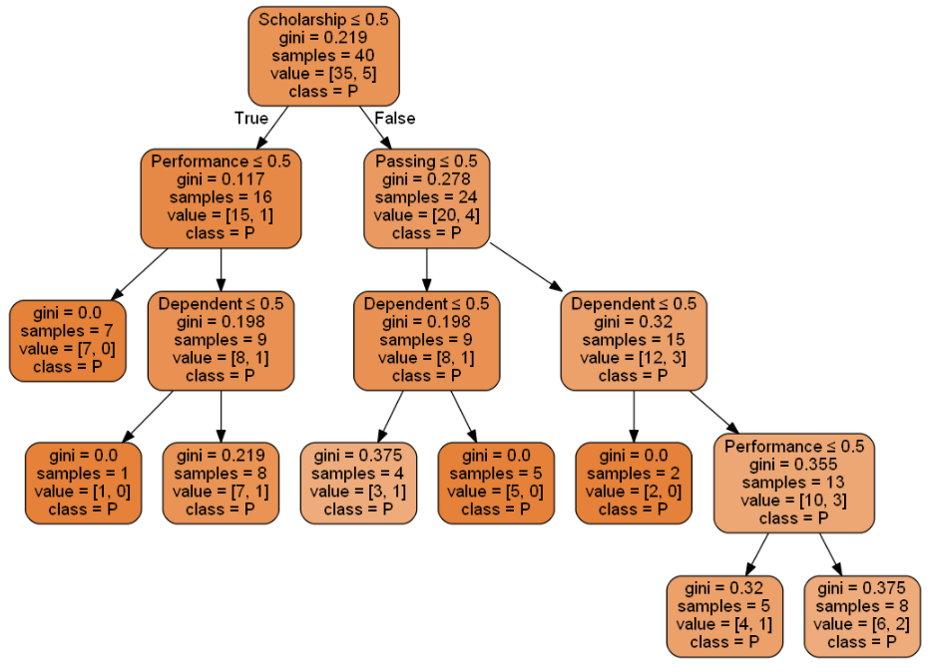
Results
Language used: Python
Environment: Jupyter
Runtime: 0.57174833
*Note: badly skewed data due to survey being taken by students in other classes

Slide 26
Reasons we chose these features:
Scholarship / Grant
Pass / Failure
Dependency / Independency
Being able to perform well in online class

Slide 27
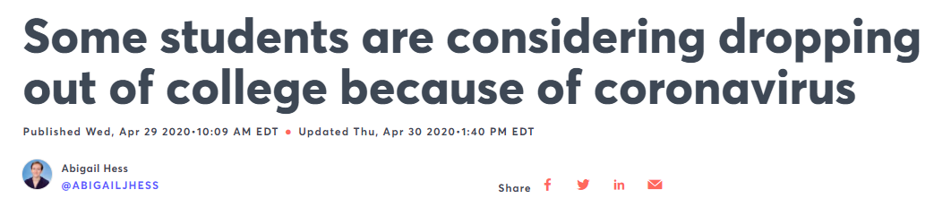
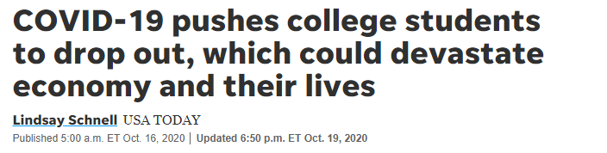
Why this research
Figure 5
Adapted from [5]
… and many more.
Figure 6
Adapted from [6]

Slide 28
Our contribution
It is known that students have been dropping classes due to corona.
This could be used as an argument as to why some colleges/universities should allow students to drop classes without any repercussions.
Universities are taking into consideration that there are other factors caused by the COVID-19 Pandemic.

Slide 29
Decision Trees and Gini Index
vs.
Other Algorithms

Slide 30
GINI INDEX vs. Other Algorithms
ID3
Uses Information Gain / Entropy
splits data by first looking for higher entropy value
CONS: can’t handle numeric data or missing
values.
: slower than Gini Index as it uses log in computation.
CART
Uses GINI INDEX
splits data by looking for the LOWEST gini index.
easier to compute
this can handle numeric data by computing adjacent data points’ averages.
inexpensive

Slide 31
GINI INDEX vs. Other Algorithms
C4.5
A better version of ID3
PROS: can handle numeric data
can handle missing data very well
can work both continuous and discrete data
more AI-like – can have a training set Decision tree induction CEASES when the number of instances to be split reaches a certain threshold
CART
Pros: easier for a simple decision tree
Cons: only favors data with larger partitions
does not really handle the issue of incomplete data very well
often biased regarding splits on a higher level

Slide 32
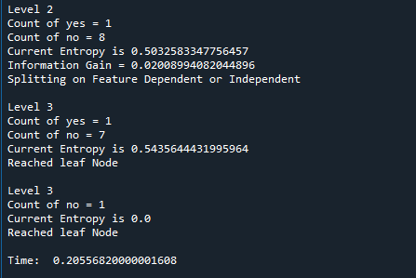
Runtime Difference
ID3

Slide 33
Decision Tree Algorithms
An NP – Complete Problem
Greedy approach
Other Decision Tree Induction Algorithms:
QUEST
CAL 5
MARS
CHAID
… and many more!

Slide 34
Sources
[1] H. Patel and P. Prajapati, “Study and Analysis of Decision Based Classification Algorithms”, International Journal of Computer Sciences and Engineering, Vol. 6, no. 10, pp. 74-78, Oct. 2018. [Online]. Available: : https://www.researchgate.net/publication/330138092 [Accessed November 27, 2020].
[2] C. Hansen, “Decision Tree Explained (Classification),” Machine Learning, September 15, 2020. [Online]. Available: https://mlfromscratch.com/decision-tree-classification/#/ [Accessed November 19, 2020].
[3] A. Ponraj, “Decision Tree,” DEV SKROL Data Science Tutorials and Articles for Beginners, July 25, 2020. [Online]. Available: https://devskrol.com/index.php/2020/07/25/decision-tree/ [Accessed November 19, 2020].
[4] H. Jiawei and M. Kamber, “Classification and Prediction,” Slides for Data Mining: Concepts and Techniques – Chapter 7, Intelligent Database Systems Research Lab: Simon Fraser University, Canada, date unknown. [Online]. Available: www.itu.dk/people/pagh/ADBT06/classification.pdf [Accessed November 17, 2020].

Slide 35
Sources
[5] H. Sharma and S. Kumar, “A Survey on Decision Tree Algorithms of Classification in Data Mining”, International Journal of Science and Research, Vol. 5, no. 4, pp. 2094-2097, April 2016. [Online]. Available: https://www.researchgate.net/publication/324941161_A_Survey_on_Decision_Tree_Algorithms_of_Classification_in_Data_Mining [Accessed November 25, 2020].
[6] Rishavbb (2018) D_Tree_Implementation [Source code] https://github.com/rishavbb/D_Tree_Implementation.
[7] Abigail Hess, “Some students are considering dropping out of college because of coronavirus,” CNBC, April 30, 2020. [Online]. Available: https://www.cnbc.com/2020/04/28/students-are-dropping-out-of-college-because-of-coronavirus.html

Slide 36
Sources
[8] Lindsay Schnell, “COVID-19 pushes college students to drop out, which could devastate economy and their lives,” USA Today, October 19, 2020. [Online]. Available: https://www.usatoday.com/story/news/nation/2020/10/16/covid-community-college-students-drop-out-economy/5927050002/ [Accessed November 29, 2020].
M. Sciandra, A. Plaia and V. Capursi, "Classification trees for multivariate ordinal response: an application to Student Evaluation Teaching," Quality and Quantity, vol. 51, (2), pp. 641-655, 2017. Available: https://libproxy.csun.edu/login?url=https://www-proquest-com.libproxy.csun.edu/docview/1871764420?accountid=7285. [Accessed November 29, 2020].
S. Tahsildar, “Gini Index for Decision Trees,” QuantInsti’s Blog on Algo Trading and Quantitative Finance, April 18, 2019. [Online]. Available: https://blog.quantinsti.com/gini-index/#Gini-Index [Accessed November 08, 2020].

Slide 37
Sources
Rokach, Lior & Maimon, “Chapter 9 – Decision Trees,” Data Mining and Knowledge Discovery Handbook, pp. 165-192, 2005. Available: www.ise.bgu.ac.il/faculty/liorr/hbchap9.pdf [Accessed November 14, 2020].
N. Grabois, “ID3 Pseudocode,” Available: https://www.cs.swarthmore.edu/~meeden/cs63/f05/id3.html [Accessed December 3, 2020].
F. Pedregosa, et al., “Scikit-learn: Machine Learning in {P}ython”, Available: https://scikit-learn.org/stable/modules/tree.html#tree [Accessed: December 3, 2020].

Slide 38
Q & A

